Slide 1

DEPI NETWORK GRADUATION PROJECT
Packet’s Path Finder

Slide 2


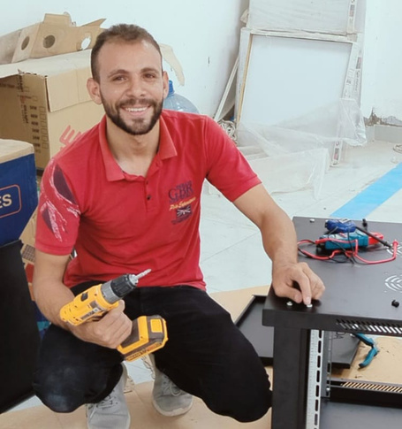

MEET THE TEAM
Abobakr Yasser
Ahmed Elhussieny
Ahmed chief
Abdallah Mohamed
Kareem mohamed
Data Center
Engineer
Multi Cloud DevOPS | Enterprise Solutions
IT technical
support
Senior technical
Support
Freelancer

Slide 3
Project OVERVIEW
The project consists of four autonomous systems (AS) and incorporates various essential networking configurations, including:
Configured VLANs 10, 20, 30, and 40.
Core Router Layer , Distribution MLS , Access Layer Switches
Configured Distribution Switches (Dist-SWs) as root primary and root secondary for Spanning Tree Protocol (STP).
Implemented HSRP on Dist-SWs for high availability.
Set up a DHCP server on routers.
Configured a DNS server for name resolution.
Established OSPF between Dist-SWs and routers.
Enable SAT / PAT For Dynamic Public Natting
Configure BGP to ISP with unique router IP

Slide 4
Project OVERVIEW
Optional Features :
Add ACL VLAN 10 in AS 300 cannot reach Web server in AS 100
-Configure security feature using DHCP Snooping
-Ensure Remote Access to network devices using telnet

Slide 5
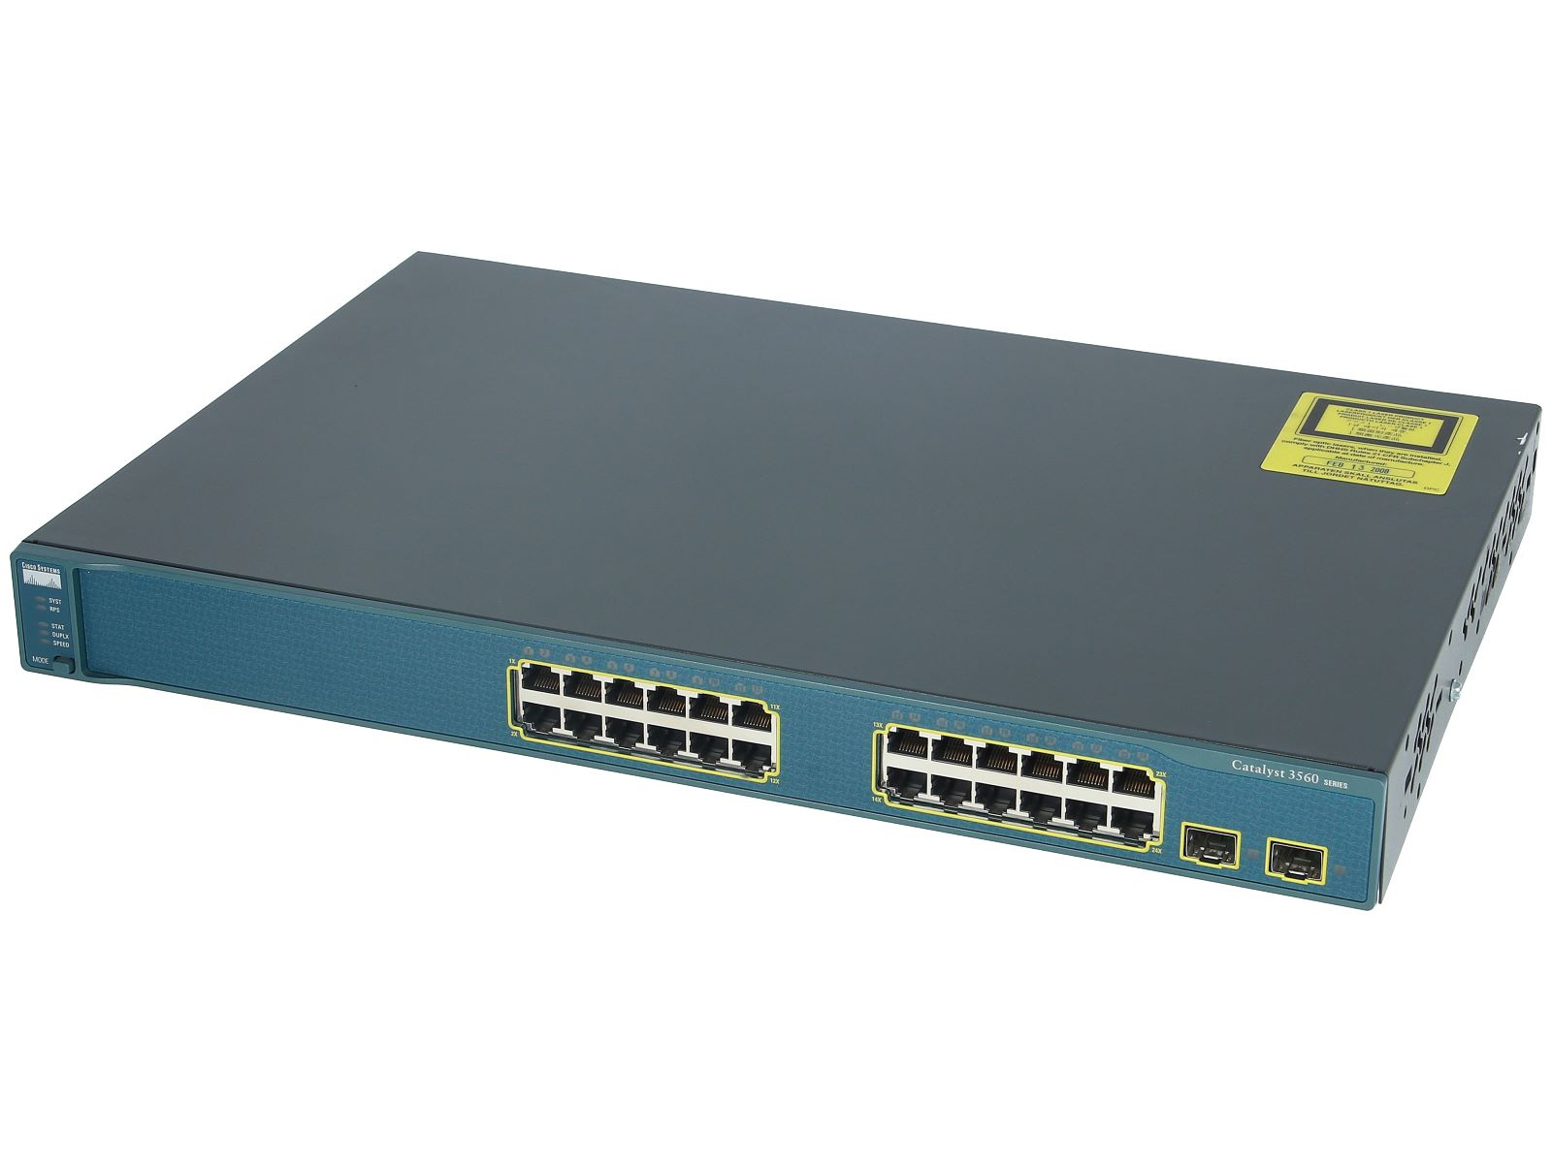
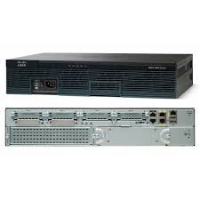

DEVICES USED
12 PCs
6 Switches
4 Multilayer Switches
4 Routers
3 Servers (2 DNS and 1 web server)

Slide 6
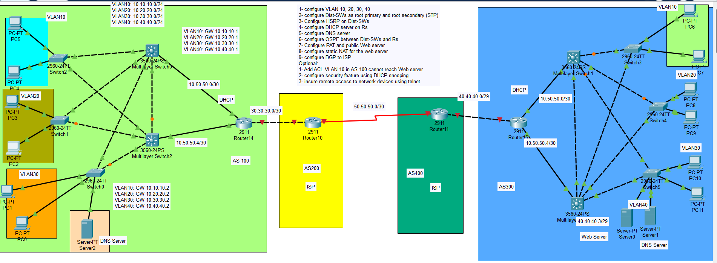
NETWORK TOPOLOGY

Slide 7

PROJECT OBJECTIVE
The main objective of this project is to apply the knowledge we’ve gained throughout the scholarship. This project integrates all the topics we’ve covered and provides hands-on experience to maximize our learning outcomes.

Slide 8

PROJECT TIMELINE
Week 1: Initial planning and research.
Week 2: Basic Device Configuration.
Week 3: Advanced Configuration and Testing
Week 4: Final review, refinement, and presentation preparation.

Slide 9
WEEK 1: INITIAL PLANNING AND RESEARCH
Defined the network requirements and brainstormed the topology.
Designed the network topology and selected the main required devices.
Determined the IP addressing scheme, including gateways and standbys.
Selected devices and applied the topology using Packet Tracer.

Slide 10
WEEK 2: DEVICE SETUP AND CONFIGURATION
Mapped out the configuration flow from access layer to the DIS layer to the core router to the ISP.
Basic Config: Disabled no ip domain lookup and assigned the hostnames.
Configured VLANs on access switches and set port types (access/trunk).
Decided between static or dynamic VLAN setup; VTP chosen, with Dist-SW1 as server and the remaining are clients.
applied the virtual IP routing.
applied the OSPF on the ML switches and the core router
Tested connectivity using static IPs for troubleshooting.
Set up HSRP for redundancy between Dist-SWs.

Slide 11
WEEK 3: DNS, NAT, AND BGP SETUP
Configured DNS server.
Set up static NAT for the web server and PAT on the core router to connect to the internet.
Applied BGP protocol to connect the core router to the ISP router.
Troubleshooting throughout each step to ensure functionality.

Slide 12
WEEK 4: FINAL TESTING AND REFINEMENT
Summarized the work and finalized troubleshooting.
Tested all configurations and ensured all deliverables were functional.
Conducted team meetings to review project outcomes.
Worked on presentation preparation.

Slide 13
CONCLUSION
Successfully set up a secure, scalable, and fully functional network.
Integrated key networking protocols like HSRP, OSPF, BGP, NAT, and ACLs.
Overcame challenges and gained hands-on experience with real-world networking configurations.
This project has been an excellent opportunity to solidify our skills and prepare us for future networking roles.

Slide 14
THANK YOU!

